Slide 1
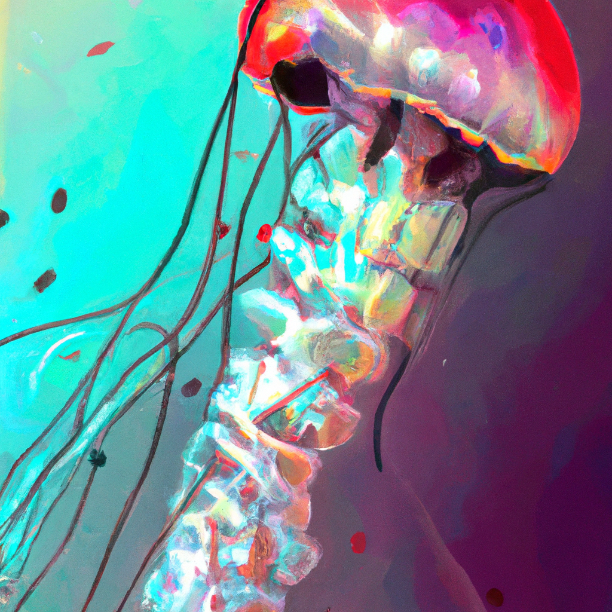
"Exploring the Fascinating World of Jellyfish: Characteristics and Habitats"
- Title: Fascinating World of Jellyfish
- Also known as medusas or sea jellies
- Inhabit the world’s oceans
- Belong to the phylum Cnidaria
- Characterized by gelatinous bodies and tentacles

Slide 2
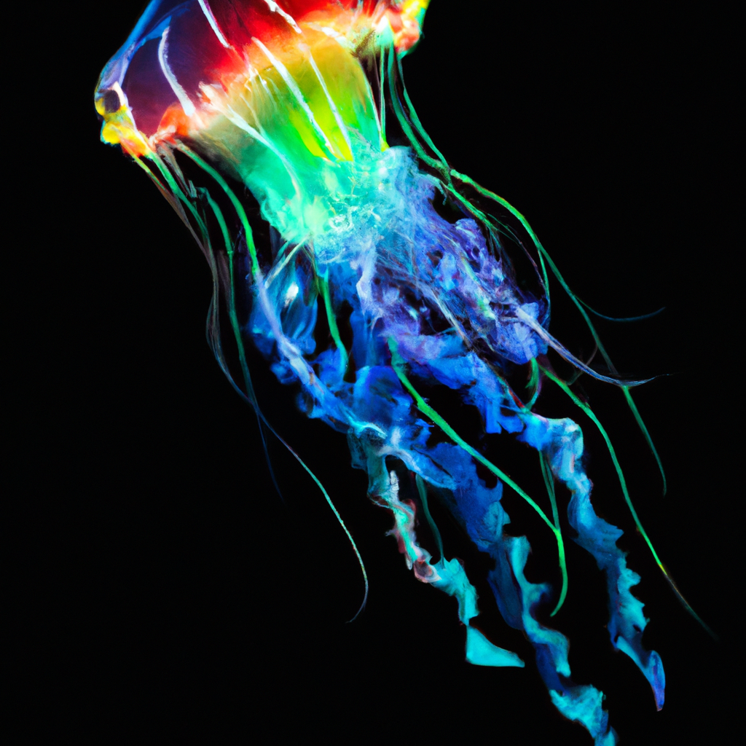
"Jellyfish: Diversity, Vibrancy, and Unique Life Cycle"
- Wide variety of Jellyfish: diverse shapes, sizes, and colors
- Small and transparent to large and vibrant
- Unique life cycle: starts as a polyp attached to the ocean floor
- Transforms into free-swimming medusa

Slide 3
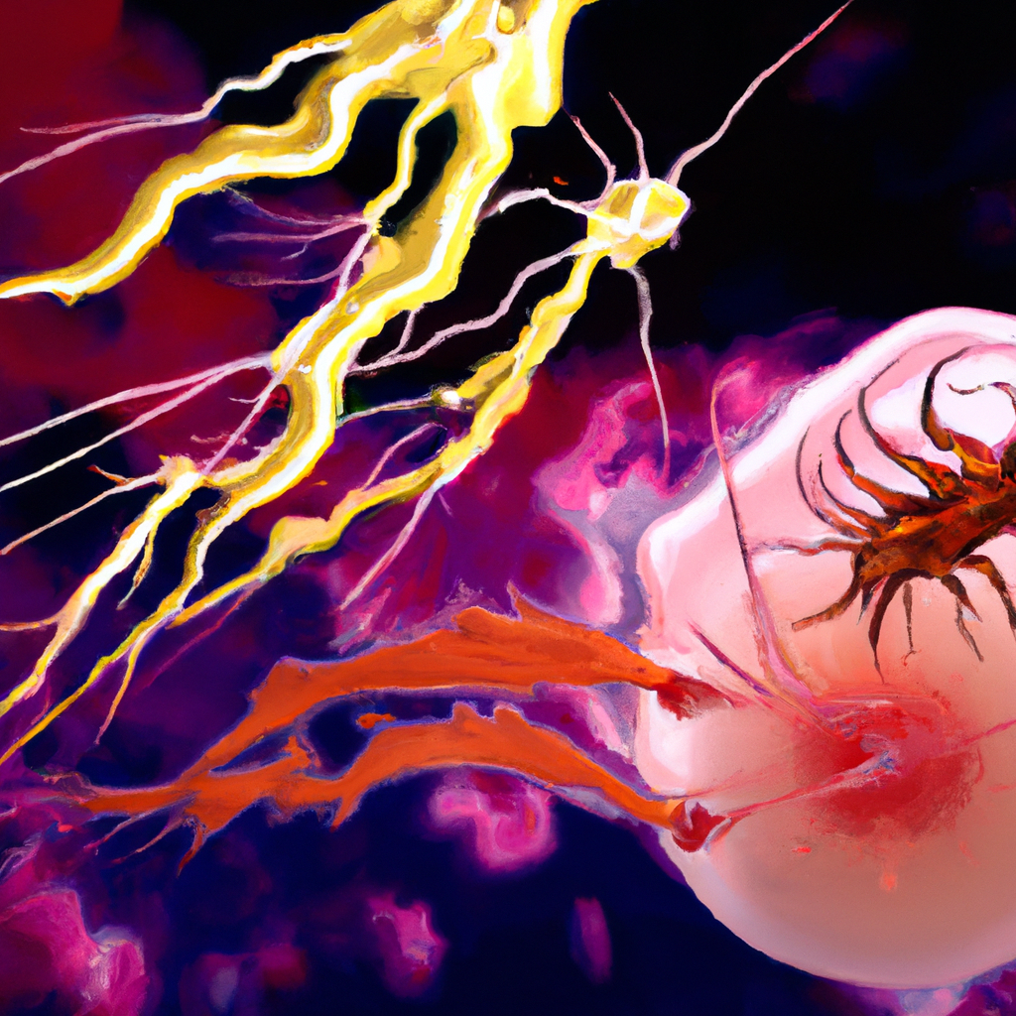
"Jellyfish: Intriguing Stinging Mechanism and Its Impact on Humans"
- Intriguing aspect of jellyfish: their ability to sting
- Specialized cells called cnidocytes contain nematocysts that deliver venom
- Stinging cells allow jellyfish to capture prey and self-defense
- Most jellyfish stings are harmless to humans
- Some species can cause painful or dangerous reactions
- Exercise caution when swimming in waters with known jellyfish populations

Slide 4
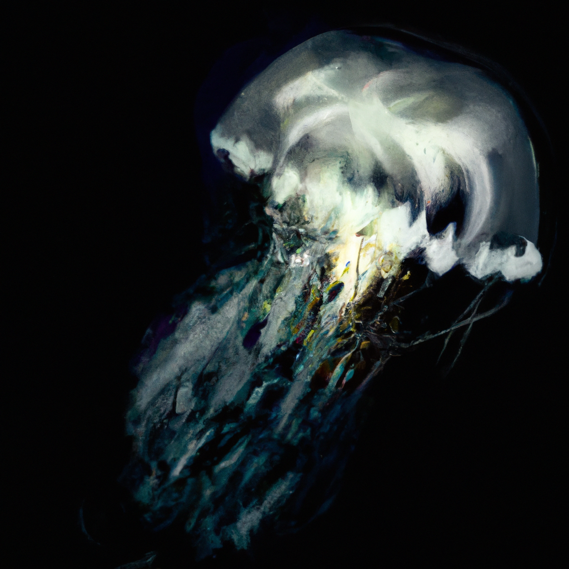
"Significant Roles and Adaptability of Jellyfish in Marine Ecosystems"
- Jellyfish: Crucial Members of Marine Ecosystems
- Act as opportunistic feeders: Consume planktonic organisms, fish eggs, and other jellyfish
- Serve as predators: Help maintain balance in the marine food web
- Show great adaptability: Capable of adjusting to changing environmental conditions

